Slide 1

Give a little, help a lot

Slide 2
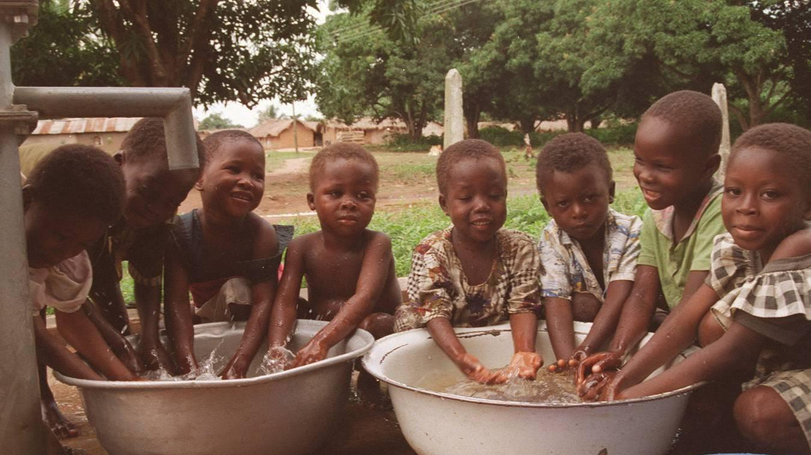
Notes:
STORY OF A SOME ONE THAT WAS HELPED AND BECAME A GREAT MAN!!!

Slide 3
Problem
NGOs experience delay or low turn-out when fundraising due to lack of structures to facilitate easy giving
Notes:
PEOPLE NEED HELP NGOS WANT TO HELP BUT THERES NO INFRASTURE TO HELP SOME OF THIS organization in Africa… Chagua Charity for instance …

Slide 4
Solution
A tool to facilitating easy and pro-active giving through mobile money transfer
Notes:
LEVERAGING ON HIGH QUALITY CONTENT.. WE DRIVE CAMPAIGNS FOR THESE INDIVIDUALS AND ORGANIZATIONS…

Slide 5
How it works

Slide 6

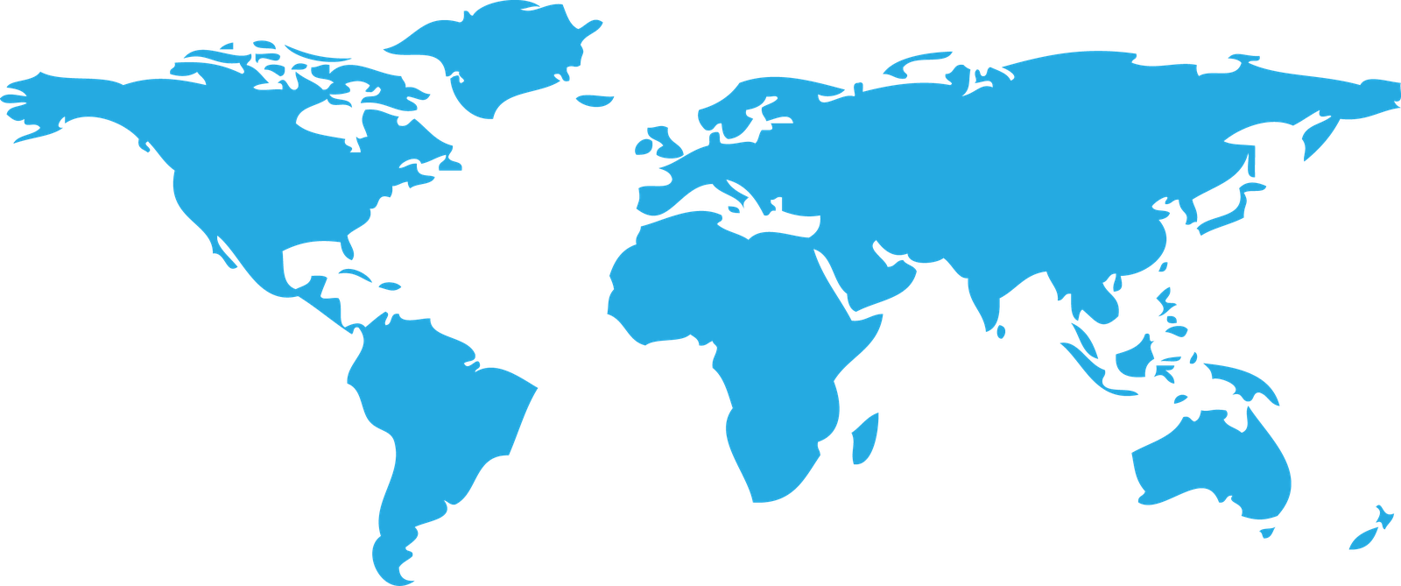
Market Size
$1.6 trillion
$3.5 billion

Slide 7






Slide 8


Revenue Model
For Givers
For Social Organisations
Big Brands
No signup or monthly fees
Low 2.9% per donation
Donations deposited next business day
Pay a premium for
sponsored content in
doGood videos, articles
and other publication
Free to download
Free to use

Slide 9
What do these fees cover
These fees only applies to organisations and it helps us cover the cost of processing each transaction, maintaining a secure and safe environment for your transactions, and improving features and benefits of the donation app.

Slide 10
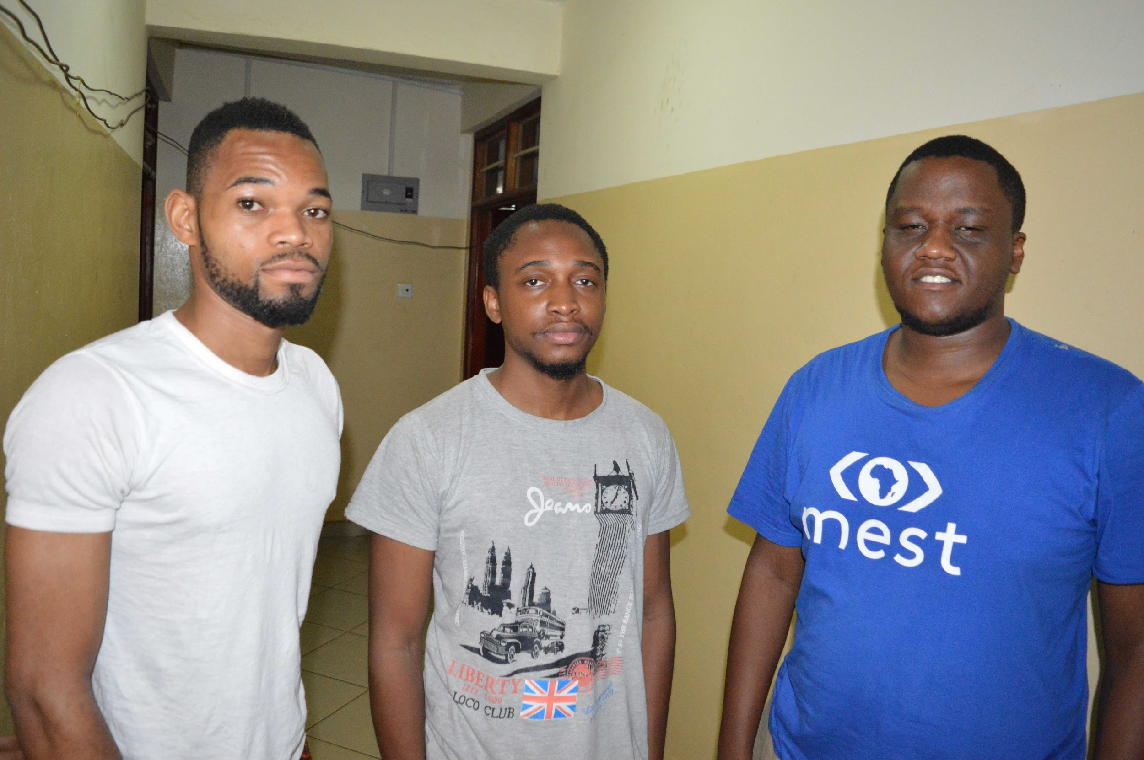
Team
Henry
Yinka
Eric

Slide 11
Thank You

